Slide 1



Real estate sales
View in Power BI
Last data refresh:
5/24/2023 9:40:43 AM UTC
Downloaded at:
5/24/2023 9:52:38 AM UTC

Slide 2
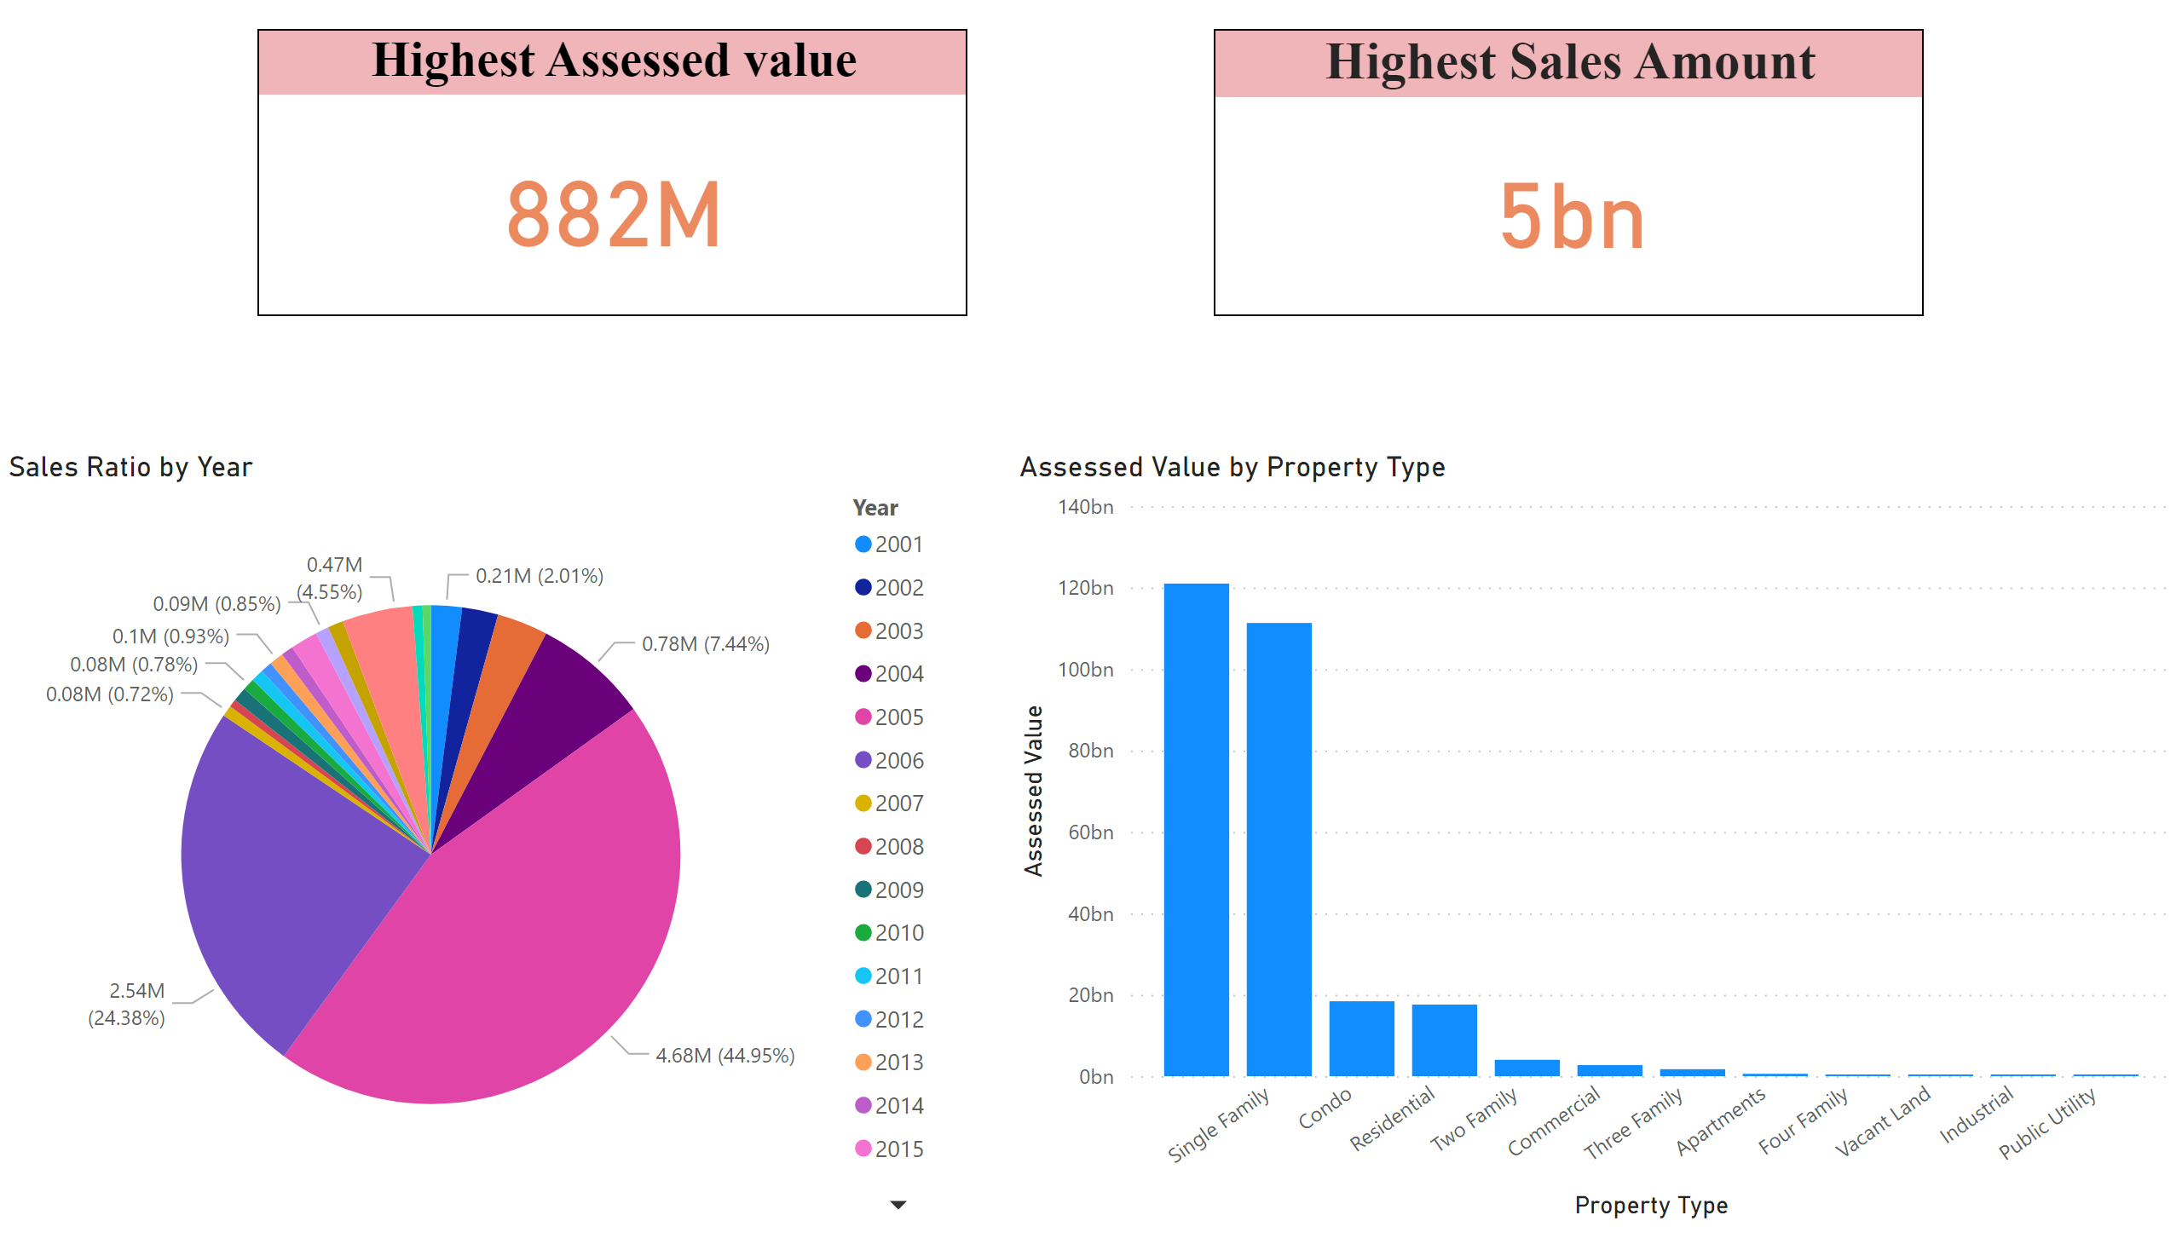
Assessed value
Notes:
pieChart
No alt text provided
Highest Assessed value
No alt text provided
Highest Sales Amount
No alt text provided
clusteredColumnChart
No alt text provided

Slide 3
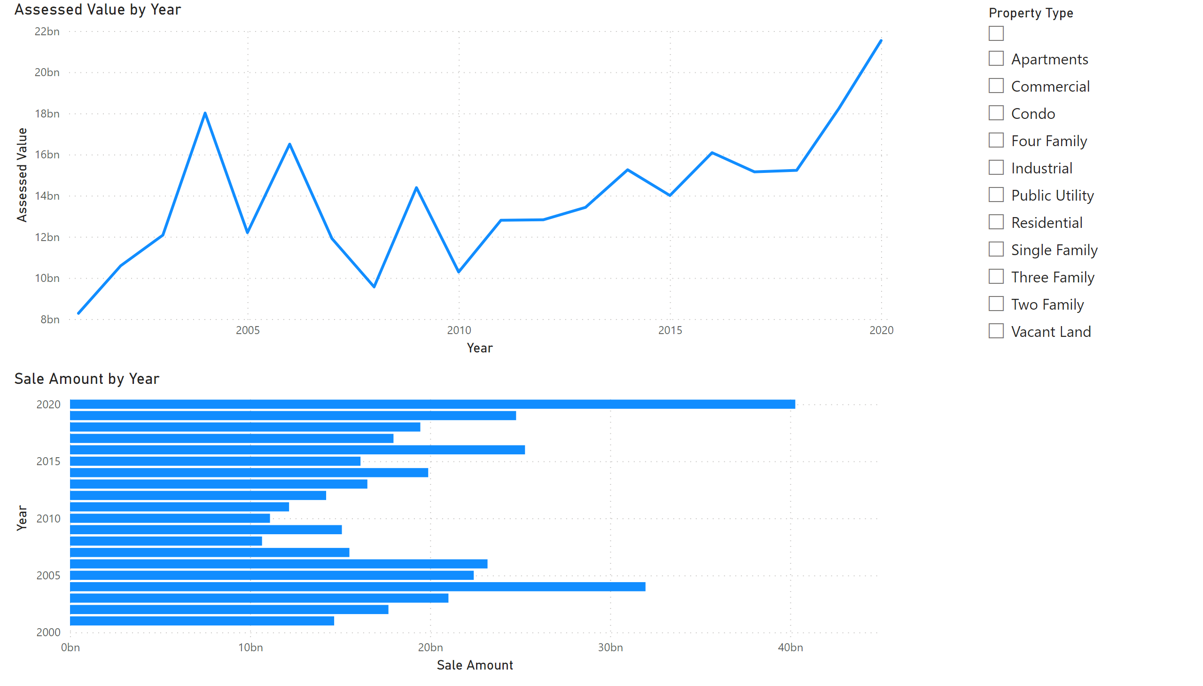
Property tpe
Notes:
lineChart
No alt text provided
slicer
No alt text provided
clusteredBarChart
No alt text provided

Slide 4
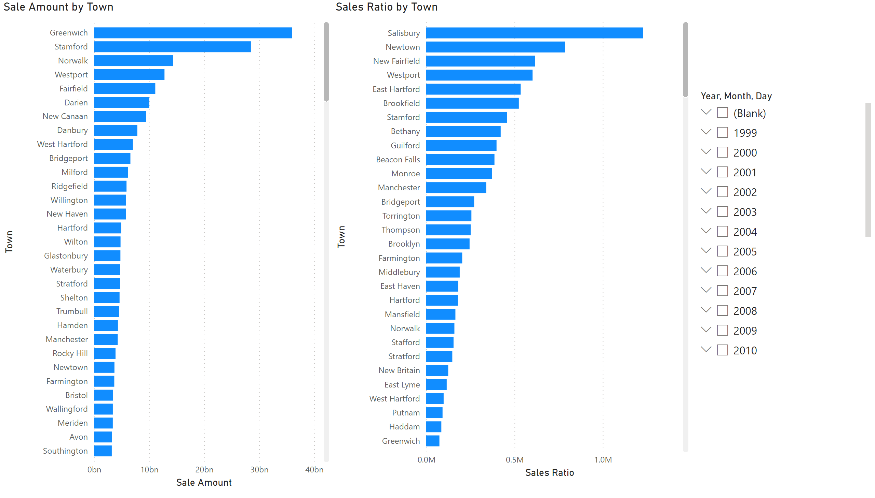
Sale by town
Notes:
Sale Amount by Town
No alt text provided
clusteredBarChart
No alt text provided
slicer
No alt text provided

